Slide 1
A
SEMINAR
ON THE TOPIC:
GENDER PRODUCTIVITY DIFFERENTIALS AMONG POULTRY FARMERS IN UYO AGRICULTURAL ZONE, AKWA IBOM STATE.
BY
EDEM, GLORY ANTHONY
AK18/AGR/AEC/ 017
SUPERVISED BY:
DR. NKEME KESIT
DEPARTMENT OF AGRICULTURAL ECONOMICS & EXTENSION
FACULTY OF AGRICULTURE
AKWA IBOM STATE UNIVERSITY
JULY, 2023

Slide 2
INTRODUCTION
Background of the study
Agriculture, particularly poultry sector is the backbone of most developing countries economies and is mostly based on small holder production systems. .
Poultry provides income, employment and manure for crops.
In Uyo agricultural zone, Akwa Ibom State, poultry tasks are often gender specific.
Women are further disadvantaged by being excluded from participating in decision-making in some programmes which involve agricultural policies that aim to promote food security and food production in the country.

Slide 3
Problem Statement
One of the key weaknesses of Nigerian agriculture is low productivity. While productivity in agriculture is generally low and thereby hindering poverty reduction, it is even lower among female peasants. The problem of this study lies in the fact that women are only seen to be productive at home. The reverse maybe the case as women can play productive roles in poultry sector and even among other agricultural sectors. This poses an issue as women participation in poultry farming in Uyo agricultural zone, Akwa Ibom State. Thus, this study aim at examining gender productivity differentials among poultry farmers in Uyo agricultural zone, Akwa Ibom State.

Slide 4
Research Questions
The following questions will guide this study:
What are the socio economic characteristics of poultry farmers in Uyo agricultural zone, Akwa Ibom State?
What are the differences in productivity between male and female poultry farmers in Uyo agricultural zone, Akwa Ibom State?
What are the other factors influencing the productivity of poultry farmers in Uyo agricultural zone, Akwa Ibom State?

Slide 5
Objectives of the Study
The main objective of the study is to examine gender productivity differentials among poultry farmers in Uyo agricultural zone, Akwa Ibom State. The specific objectives of the study are:
To determine the socio-economic characteristics of poultry farmers in Uyo agricultural zone, Akwa Ibom State
To examine the differences in productivity between male and female poultry farmers in Uyo agricultural zone, Akwa Ibom State
To investigate the other factors influencing the productivity of poultry farmers in Uyo agricultural zone, Akwa Ibom State

Slide 6
Research Hypotheses of the study
H0₁: There are no differences in productivity between male and female poultry farmers in Uyo agricultural zone, Akwa Ibom State.
H0₂: Socio-economic characteristics of poultry farmers does not have any significant influences on their productivity.
Conceptual Definition of Terms
Gender: The state of being male or female
Gender Productivity Differentials: This is a measure of the productivity between males and females in a specific location
Poultry Farmers: These are farmers involved in rearing chickens and hens
Uyo agricultural zone, Akwa Ibom State: This is the agricultural sector of Uyo.

Slide 7
Justification of the Study
This study was carried out to understand the gender productivity differentials among poultry farmers in Uyo agricultural zone, Akwa Ibom State. It also brought to light reasons and factors behind the prevalent gender productivity differentials in Uyo agricultural zone, Akwa Ibom State. The Uyo agricultural zone, Akwa Ibom State and other parts of Akwa Ibom in general have been victims of this trending issue of gender productivity differentials where it seems as if men alone can do the work leaving women sidelined or reduced in number. With this study, women can see the need to join and be productive parts of poultry farms in Uyo agricultural zone, Akwa Ibom State.

Slide 8
METHODOLOGY
Research Design
A research design is a plan, structure and strategy of investigation applied so as to obtain answers to research questions and to control variables. The design allows researchers to sharpen the research methods suitable for the subject matter and set up their studies for success. (Ekott and Nseyen 2006). The study used survey research technique which allows the collection of data from the population in a highly cost-effective way.
Population of the Study
The population of the study included all poultry farmers in Uyo agricultural zone, Akwa Ibom State.

Slide 9
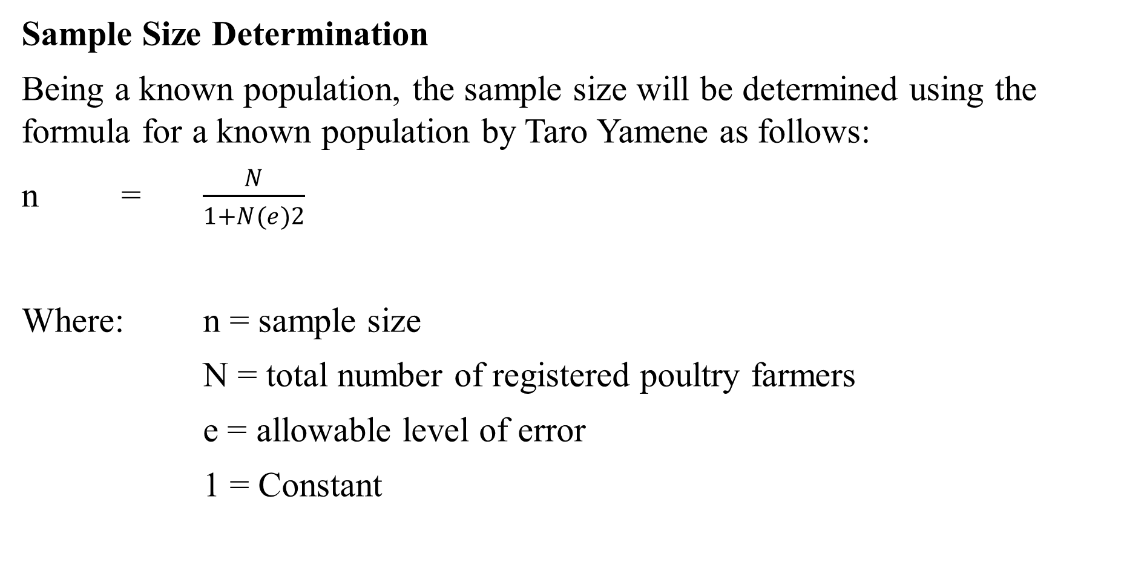
Sample Size Determination
Being a known population, the sample size will be determined using the formula for a known population by Taro Yamene as follows:
n = $\frac{N}{1+N(e)2}$
Where: n = sample size
N = total number of registered poultry farmers
e = allowable level of error
1 = Constant

Slide 10
Sampling Technique
The research will make use of multi stage sampling technique.
First will be purposive selection of Uyo agricultural zone because of high concentration of poultry farmers.
In the Second stage, four (4) extension blocks will be chosen from the existing six (6) block.
In the third stage three (3) extension cells will be chosen from each of the blocks making a total of twelve (12) cells.
Lastly, fifteen (15) poultry farmers will be selected from each of the selected cells making a total of 180 poultry farmers that will be used for the study selection of blocks, cells and poultry farmers will be by balloting.

Slide 11
Sources of Data
Data for this research will be gotten from primary and secondary sources. The primary source comprises of information relevant to this study that were obtained through the use of questionnaires. The secondary source refers to information obtained from existing materials. This include historical materials collected from organizations, textbooks, journal, articles, internet and other publications related to the subject matter of study.
Data collection Instrument
The research instrument that will be used in the collection of data in this study is the questionnaire. In a bid to get the precise opinion, the questionnaire will be designed in a way that enabled respondent to choose the most appropriate option out of the alternative questions. The questionnaire will be arranged in two sections, the first briefly captured the demographic information of the respondents while the second part focused on questions bordering on the subject matter. The questions in the questionnaire will be close-ended and were also drafted in a simple, explicit and understandable language.

Slide 12
Validity of the Research Instrument
The instrument that will be used will be developed by the researcher in accordance with the research topic. The content validity of the instrument will be determined by the supervisor who matched the variables of the instruments with the research questions in order to determine whether or not the instruments measured what they are supposed to measure. The questionnaire will be presented to my supervisor and another lecturer in the department since this type of validity cannot be put into statistical test. They will successfully assess the instrument and make suggestions.
The suggestions will be taken care of and changes will be made where necessary. This idea will make sure that questionnaire covers what it is supposed to cover. This will make the questionnaires to be deemed valid to be employed to collect data in the main study.

Slide 13
Method of Data Analysis
These sections specified the statistical tools that will be used for data analysis.
Objectives (i) Will be analyzed using descriptive analyzed such as means, frequency sample percentages and standard deviation.
Objective (ii) Will be analyzed using the Z statistics the test formular is as follows
Where, Zcal is the calculated value of Z distribution
X₁ is the mean of productivity of female farmer
X₂ is the mean productivity of male poultry farmer
S₁² is the value for male farmers
S²₂ is the value for female farmers
Λ₁ = Number of male farmers
Λ₂ = Number of female farmers
Decision Roles: the role hypothesis will be rejected if the value of Z calculated will be greater than its tabulated value using 0.05 level of significance.

Slide 14
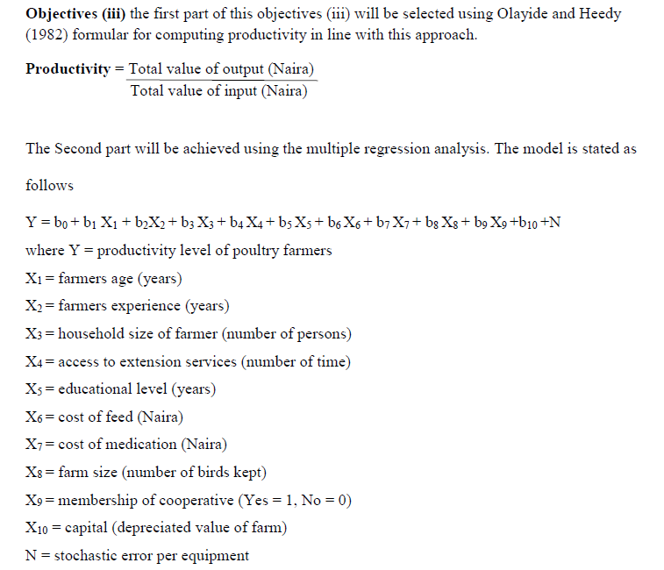

Slide 15
THANK YOU!!

